Slide 1
Should I Be Worried
Natural Disaster App Presentation

Slide 2
Intro
Have you ever hunkered down in your own home during a natural disaster and feared for your and your loved ones safety? Unfortunately, we cannot 100% predict the forces of nature, but thanks to weather forecasts and other data, we can monitor and follow it. With our app, Should I Be Worried, we can deliver an eye in the sky via news and weather alerts. We want to give any additional peace of mind to those who are in the wake of anything, be it a tsunami, wildfires, a hurricane, or a dust storm.
Our future plan is to give specific details about the weather that will let you know if there are any indicators that may lead towards any dangerous weather or a method to track the path of the disaster and see if there is a need to evacuate. Attributes such as air pressure, rainfall, intense smoke and how dry/arid it is.

Slide 3
In a sentence...
‘Should I Be Worried’ delivers news and weather information based on your location.

Slide 4
What Problem Are We Solving
User Story:
John hears that a natural disaster is approaching. He’d like to know the current weather and any news information on the impact zone.
Weather info based on location
News info based on location that is relevant

Slide 5
Demo
Demonstration of the location “Miami”
Talk about the weather information being pulled
Talk and Click on news being pulled
Talk about the Firebase Like button

Slide 6
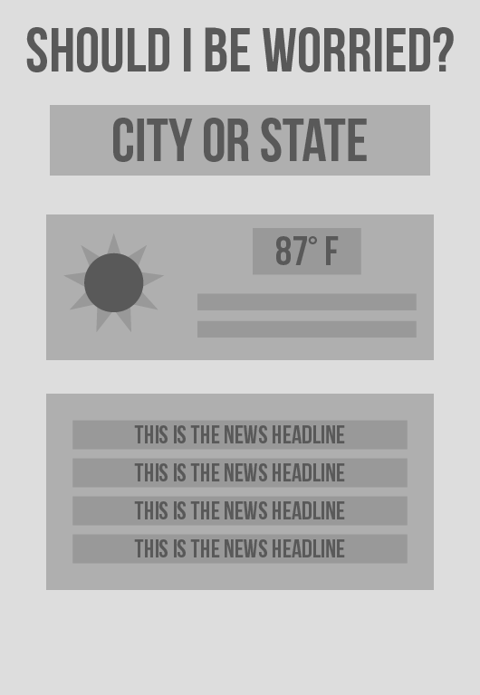
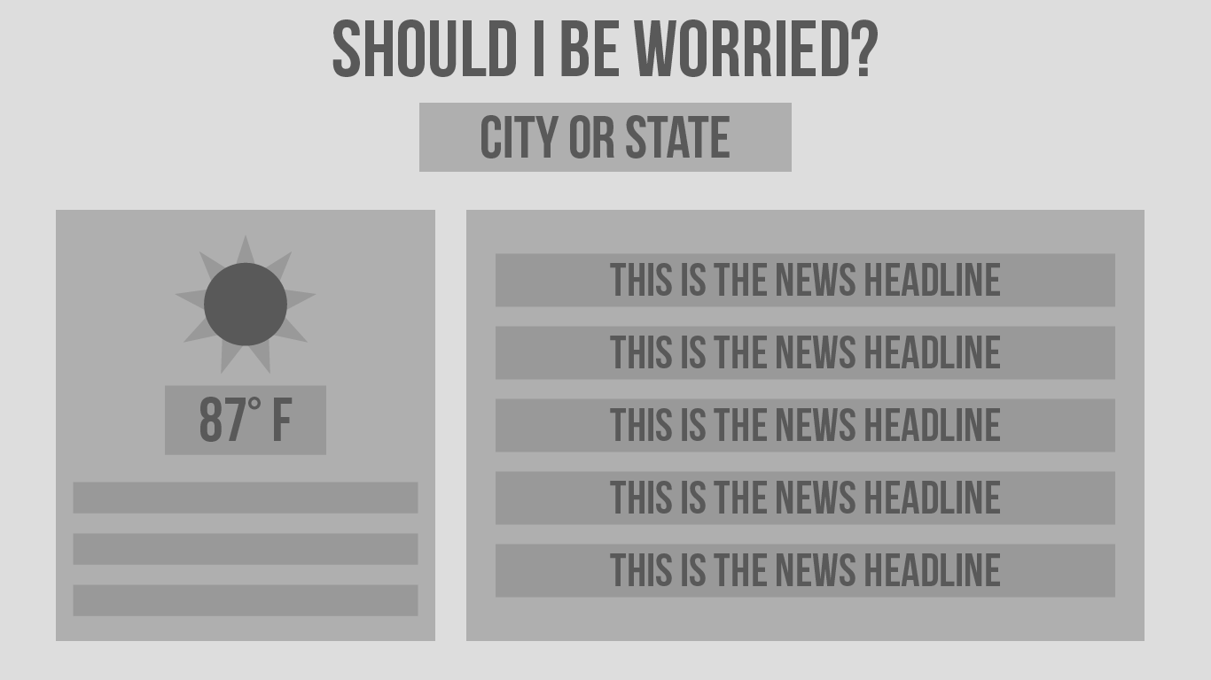
2. Initial Mockups

Slide 7
3. Steps To Build
We researched APIs
OpenWeather
PredictHQ
WebHose
NewsRiver
Google Maps
We built the HTML + CSS Skeleton using Bootstrap
We built the different functions and API calls, starting with NewsRiver first and then OpenWeather.
We made our final polishes to the CSS, HTML, and JavaScript (FireBase, CSS edits, Mobile Responsiveness)

Slide 8
4. Technologies We Used
OpenWeather API
NewsRiver API
jQuery
Bootstrap
FontAwesome
Firebase
Google Fonts

Slide 9
5. Roadblocks
News API issues
OpenWeather and NewsRiver compatibility issues
GitHub conflicts

Slide 10
3. Expanded Scope in the Future
Travel information (Cancelled Flights, Bus Routes, Trains etc.)
Shelter information (Lost person registry, shelter locations)
Geolocation that detects user location (User Experience Improvement)
More specific alerts on the specific natural disaster (User Experience Improvement)

Slide 11
Q&A
Open for Q&A….

Slide 12
Thank you!
Team Members:
Olga
Gabriel
Trent
Sergio

